Slide 1
Jermyn Borough Council Meeting
04/07/19

Slide 2
Meeting Agenda
Call to Order
Pledge of Allegiance
Roll Call
Mayor’s Proclamation
  Proclamation and Certificate for Longworth’s Family Restaurant 20 Years in Business
Previous Meeting Minutes
MS4 Public Service Announcement
Bills Payable
Correspondence
Public Comment
Junior Councilperson Program
Contact with Senator Blake
Police Chief Contract Follow Up
Police Pension Plan Follow Up
Jermyn 150 Update
Scout Corner
Chickens
New Business
Adjournment

Slide 5


Slide 6


Slide 8
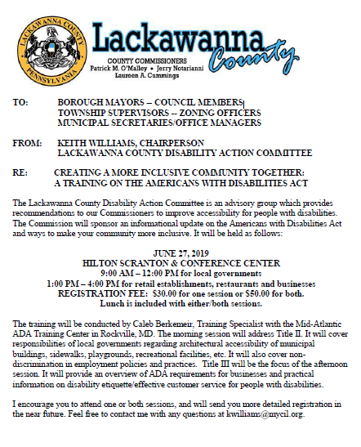

Slide 9
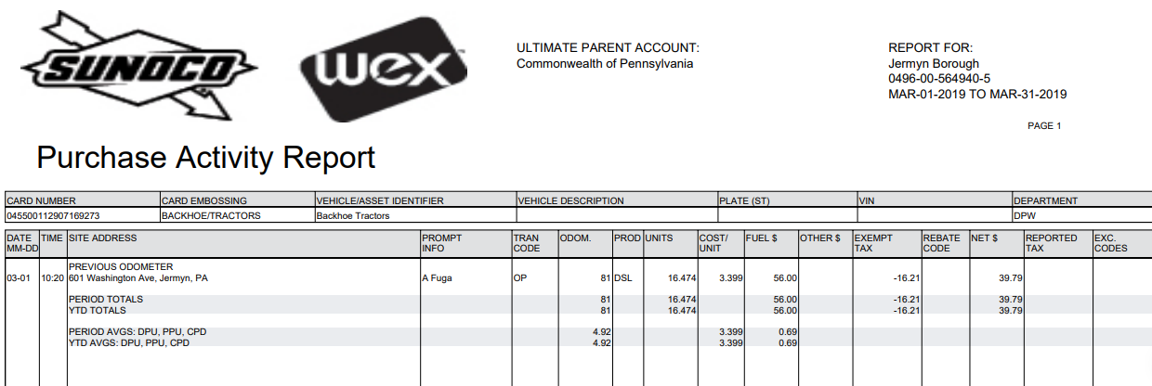

Slide 10
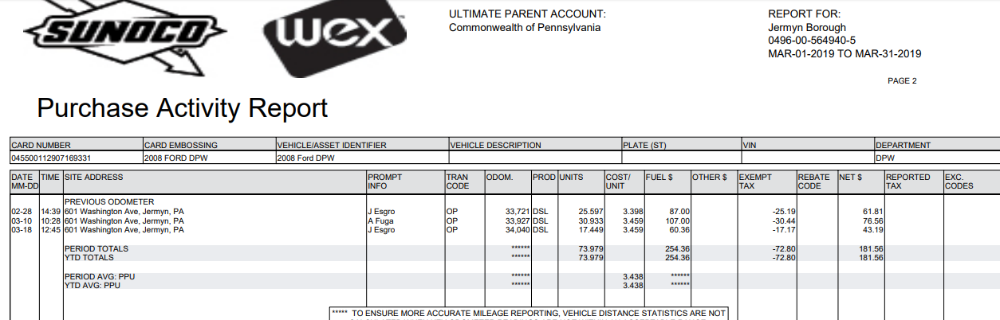

Slide 11
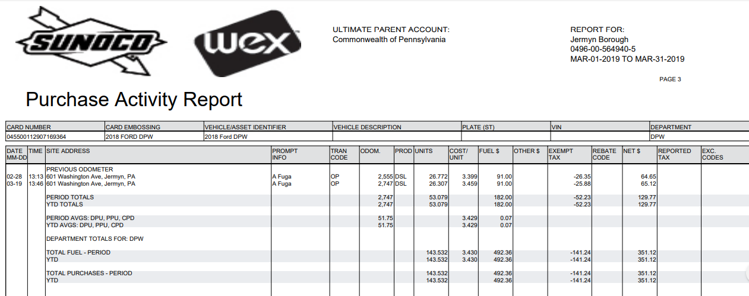

Slide 12
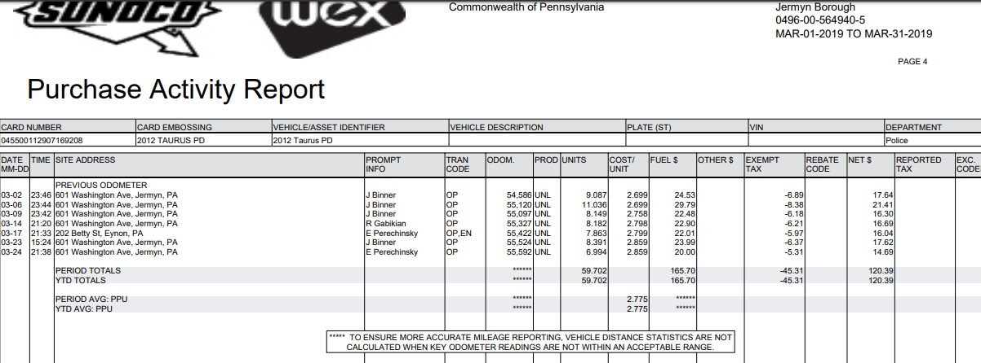

Slide 13
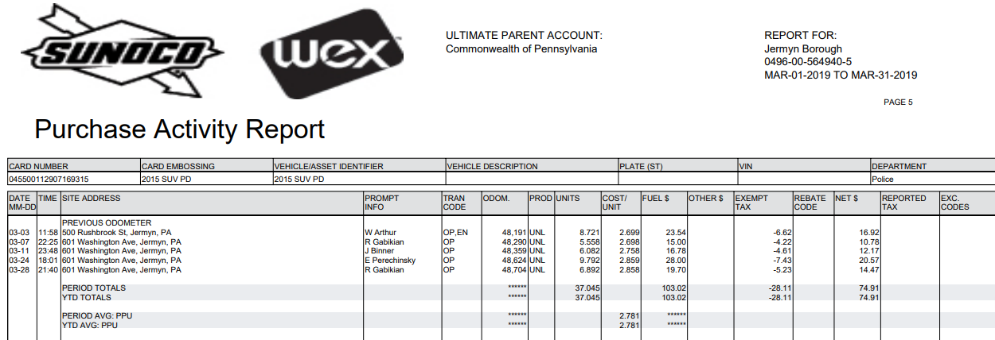

Slide 14
